Slide 1
Pardes India Inc.
Optimal Location for opening an Indian Restaurant
in
vicinity of Schaumburg, IL

Slide 2
Optimal location for opening new Indian Restaurant
"Pardes India Inc." a large Indian restaurant chain operating out of Mid-West USA.
Already having few restaurants in Chicago metropolitan area.
Looking to expand in many Chicago Suburbs.
Key area identified as vicinity of Schaumburg in Northwest suburbs of Chicago.
Schaumburg with sizeable Indian population is potentially a great business opportunity. It is also famous for Woodfield Mall and has offices of many multi-national corporations.
Identify optimal location in suburbs in vicinity of Schaumburg IL, which is not crowded with Indian restaurants and has reasonable Indian population and the household income of the area is on higher side.

Slide 3
Data Collection
Zip codes in each suburb scraped from zipmat.net
Demographic data scraped from zipdatamaps.com
Restaurant data using Foursquare API
Geopy "geocode.Geolake" to get location coordinates
Geopy “geocode.Nominatim” to get the addresses

Slide 4
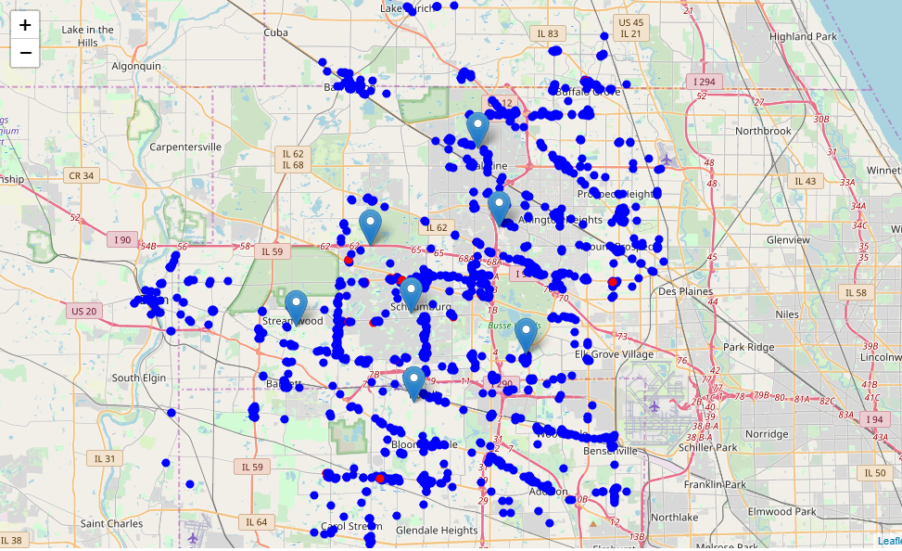
Location all Restaurants and identifying Indian Restaurants
Total Restaurants : 1413
Indian Restaurants : 32
Avg. Restaurants per
zip code : 47
Percentage of India
Restaurants : 2.26%
Legend
Indian Restaurants
All Other Restaurants

Slide 5
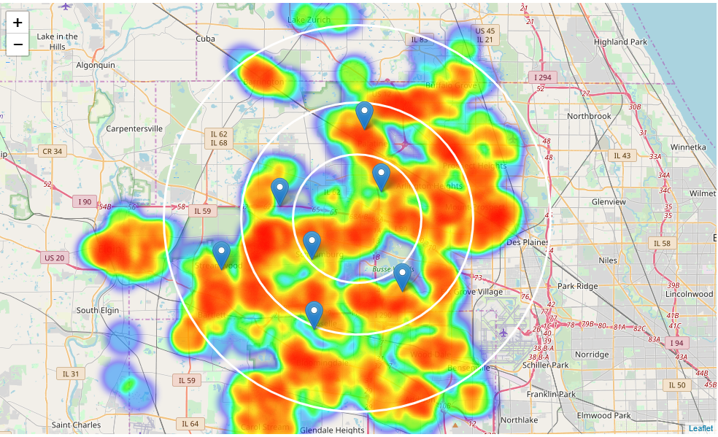
Heat Map of all Restaurants
Restaurants are generally all around the suburbs.
However, there are few restaurants in North West direction.

Slide 6
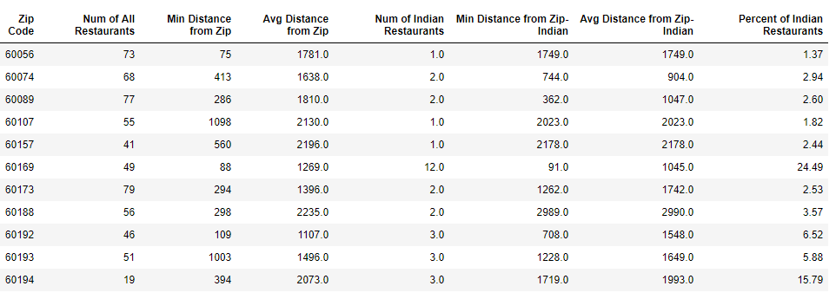
Where are Indian Restaurants?
Indian restaurants are in 11 of 30 zip codes.
Four zip codes have more than 5% of Indian restaurants.
Zip codes 60169 and 60194 have high number of Indian restaurants.

Slide 7
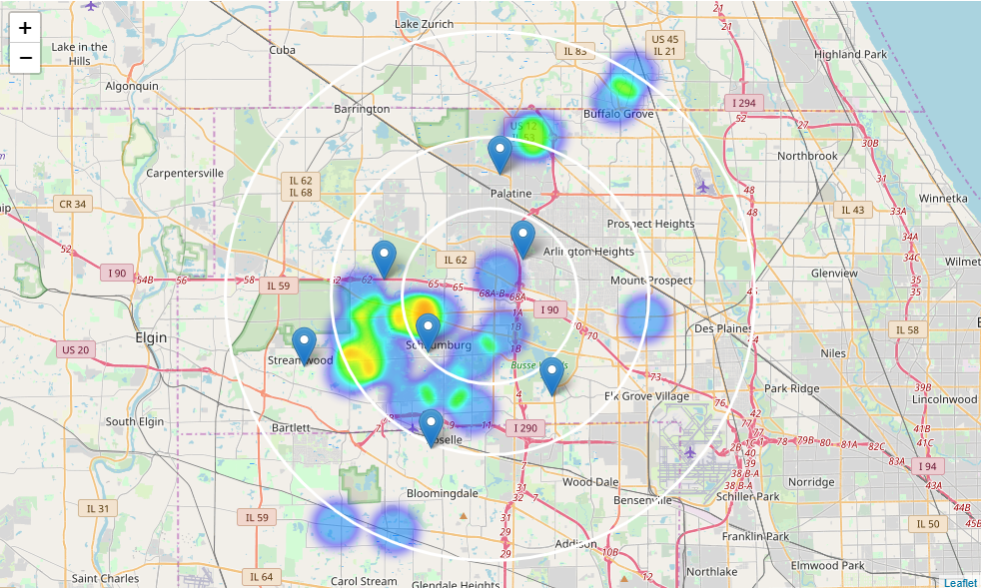
Heat Map of Indian Restaurants
Most of the restaurants are located in the triangle of Schaumburg, Hoffman Estates and Streamwood.

Slide 8
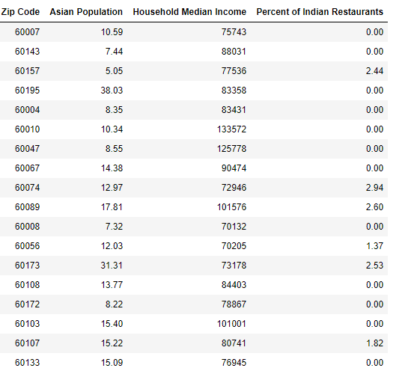
18 candidates zip codes for opening Indian Restaurants
Criteria applied:
No. Indian Restaurants < 5%
Asian Population > 5%
Household Income > 70K

Slide 9
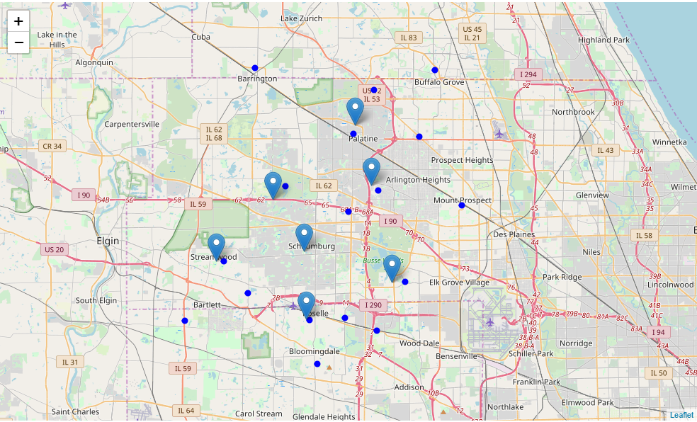
18 candidates zip codes on map
Criteria applied:
No. Indian Restaurants < 5%
Asian Population > 5%
Household Income > 70K

Slide 10
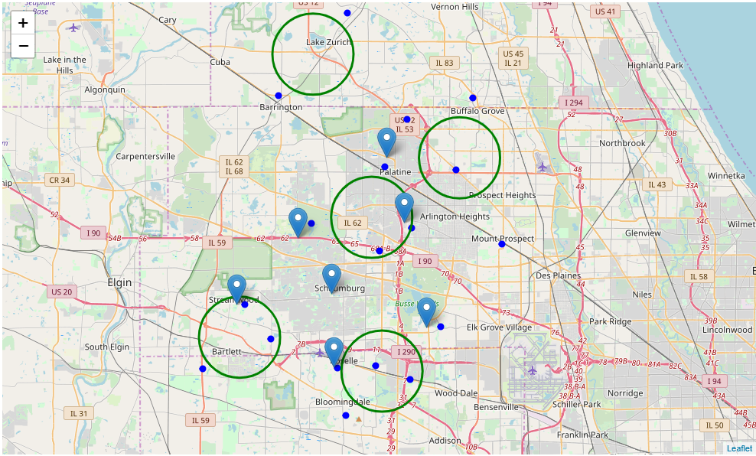
Zip codes clustered in 5 zones for further exploration
Criteria applied:
No. Indian Restaurants < 5%
Asian Population > 5%
Household Income > 70K
Addresses of center of 5 zones:
2684, Mill Creek Lane, Rolling Meadows, Cook County, Illinois, 60008
448, East Lake Street, Streamwood, Cook County, Illinois, 60107
MB Financial Bank, Rand Road, Lake Zurich, Lake County, Illinois, 60047
2460, North Douglas Avenue, Arlington Heights, Cook County, Illinois, 60004
Terrace Drive, Medinah, DuPage County, Illinois, 60157

Slide 11
Conclusion and Next Steps
Identified 5 zones with their centers that can be used as starting point to explore exact location for opening an Indian Restaurant.
Final decision will need further exploration and may consider additional data e.g. crime rate, age grouping, education, commercial activity, real estate, fun areas etc.

